Slide 1
POCUS PASSPORT:
EFAST MINIMUM IMAGING SET AND AUDITING GUIDE

Slide 2
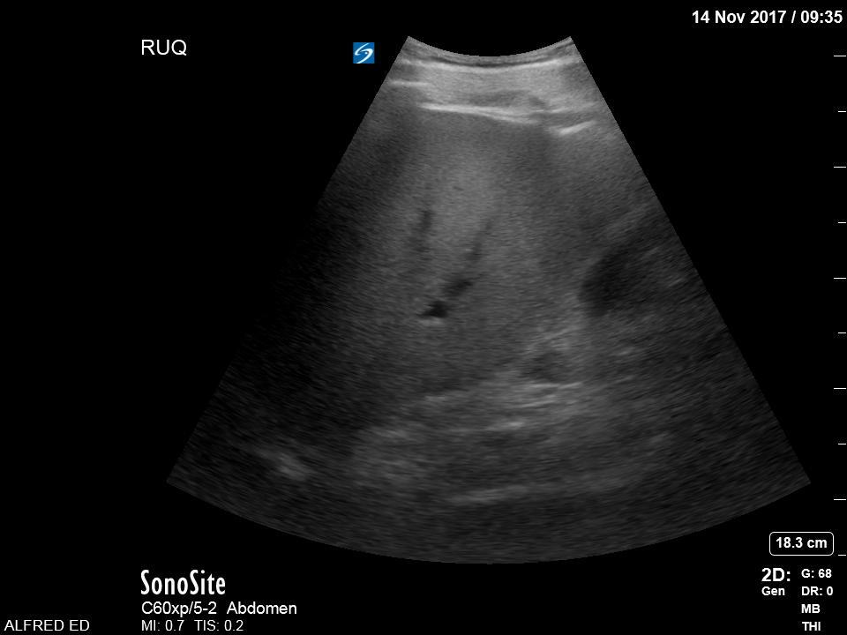
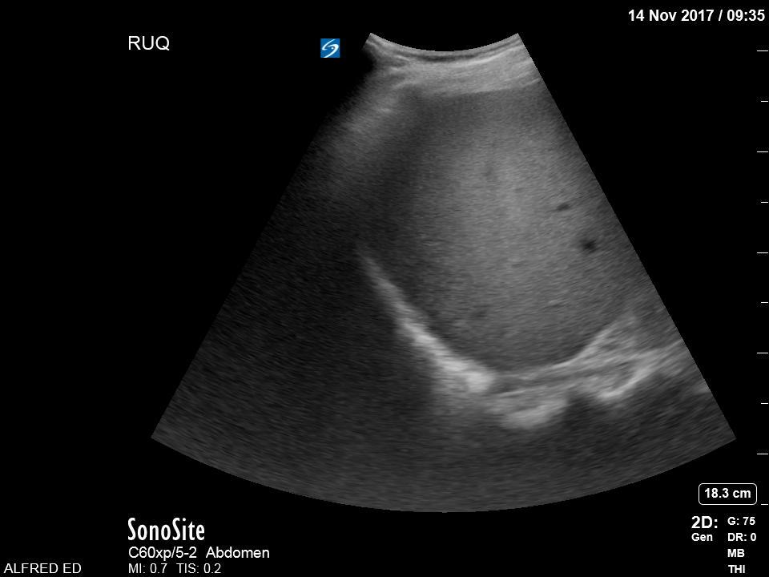
Coronal view in the right mid-axillary line
Labelled RUQ
Curvilinear probe on abdominal present
Depth and gain optimised
Image set must include:
Right Kidney;
Liver (incl liver tip)
Morrison’s Pouch;
Right Diaphragm
Right pleural space
AND demonstrate the potential space for fluid collection:
Hepatorenal Interface (Morrison’s Pouch);
Right Diaphragm/hemithorax
Right Paracolic Gutter
Right Upper Quadrant

Slide 3
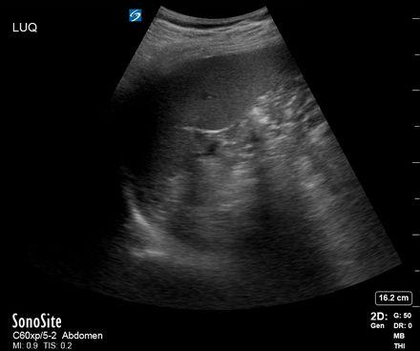
Coronal view in the left mid-posterior axillary line
Labelled LUQ
Curvilinear probe on abdominal present
Depth and gain optimised
Image set must include:
Left Kidney;
Spleen;
Left Diaphragm.
Left hemithorax and pleural space
AND demonstrate the potential space for fluid collection:
Splenorenal Interface;
Left Subdiaphragmatic/ Perisplenic Space;
Left Paracolic Gutter.
Left hemithorax
Left Upper Quadrant

Slide 4
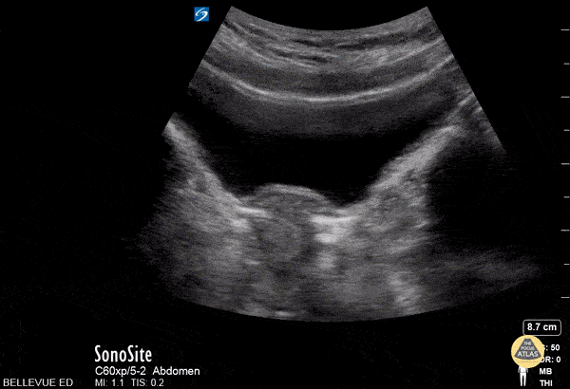
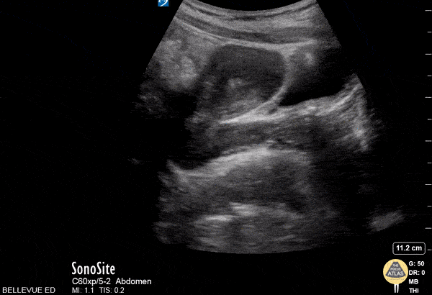
Sagittal midline view 2cm superior to the symphysis pubis followed by transverse from pubic symphysis through pelvis to bowel.
Curvilinear probe on abdominal present
Depth, gain and TGC optimised
Labelled Pelvic
Female patients:
Images must contain
Bladder
Uterus
Pouch of Douglas
Rectum
Pubic symphysis in long
AND Identify potential space for fluid collection
Vesico-Uterine Space
Pouch of Douglas
Pelvis Trans
Pelvic View - Female
Pelvis Long

Slide 5
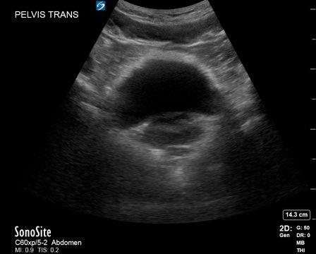
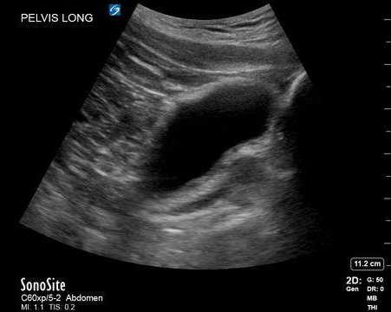
Sagittal midline view 2cm superior to the symphysis pubis followed by transverse from pubic symphysis through pelvis to bowel.
Depth Gain and TGC optimised
Labelled Pelvic Transverse/Long
Male Patients:
Images must contain:
Bladder
Prostate
Rectum
Pubic symphysis in long
AND demonstrate the potential space for fluid collection
Vesico-Rectal Space
Pelvic View - Male

Slide 6
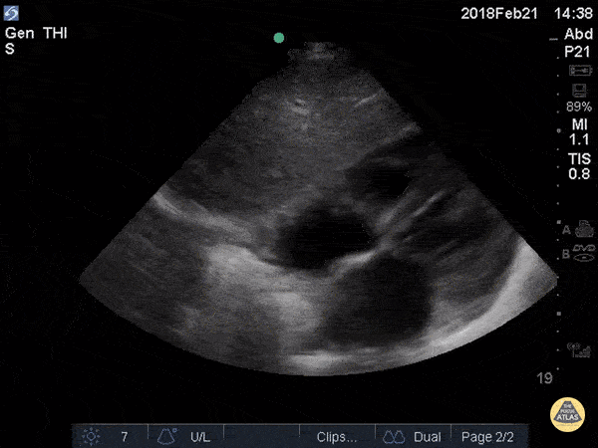
Transverse view through the subxiphoid region of the chest (alternative left long axis parasternal or apical views also acceptable if subxiphoid view non-diagnostic)
Curvilinear probe on abdominal present (or phased array probe on cardiac preset)
Depth and gain optimised
Labelled SUBX/ PLAX/ APIC
Still or cineloop
Images must include:
Liver (SUBX)
Heart (in 4 chamber view, or long axis parasternal view if required)
Pericardium
AND be able to demonstrate the potential space for fluid around pericardium
Sub-Xiphoid/Pericardial View

Slide 7
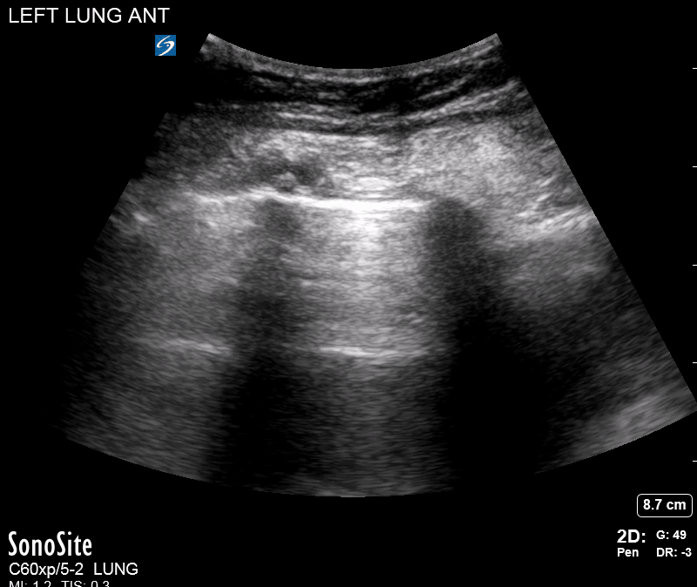
Longitudinal view at most anterior region of right and left chest
Labelled Rt or Lt
Linear or Curvilinear probe. Decrease depth to < 6cm to look at pleural line.
Focus set to pleural line if available.
Cineloop more appropriate.
Recognise the sonographic features of pneumothorax
absence of lung sliding
Lung point
If no sliding look for lung pulse and B-lines to exclude pneumothorax
Can Acquire an M-mode trace
Lung View

