Slide 1
POCUS PASSPORT:
FOCUSED ECHO IN LIFE SUPPORT MINIMUM IMAGING SET AND AUDITING GUIDE

Slide 2
Views may include subcostal, parasternal long axis, parasternal short axis, apical 4 chamber and IVC longitudinal
Select phased array probe on cardiac preset
Would be suitable to select abdominal probe preset for subcostal views.
The views will be dictated by the clinical scenario and patient factors. It is recognised that in many patients, not all views will be of good quality.
Some echocardiographic windows may be inaccessible due to other factors such as contemporaneous procedures like Cardio-Pulmonary Resuscitation (CPR).
Scan Technique

Slide 3
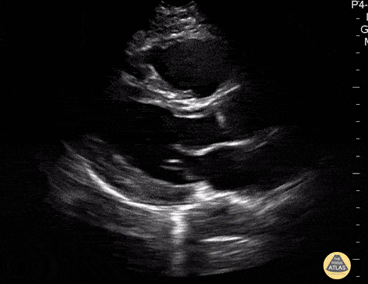
Left parasternal view of heart in long axis with focus over septum, aortic and mitral valves.
Depth and Gain Optimised
Labelled PLAX
Cineloop of at least 4 seconds
Demonstrate the right ventricle, left ventricle, mitral valve, aortic valve, ascending aorta and left atrium. May include a cineloop with increased depth to view descending aorta before decreasing depth.
Assess LV and RV size as a ratio to each other (LV 2/3 RV 1/3)
Assess RV to AoV/root to LA size ratio (roughly 1:1:1)
Assess overall LV ventricular function normal vs abnormal
Identify pericardial effusion
Identify fluid in the pleural cavity
Parasternal Long Axis View
PLAX

Slide 4
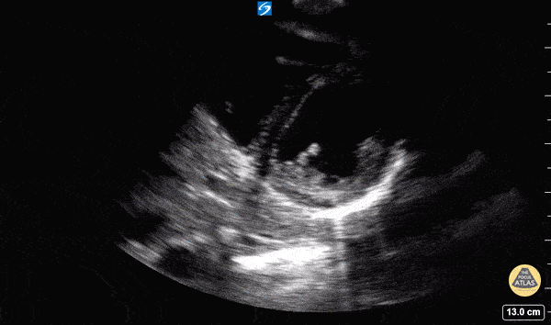
Left parasternal view of heart in short axis with focus over septum, aortic and mitral valves.
Depth and Gain Optimised
Labelled PSAX
Cineloop of at least 4 seconds
Aim to have the LV in the middle of the sector looking like a doughnut with the two papillary muscles visible in the LV cavity
Assess overall ventricular function normal vs abnormal
Assess the shape of the LV, round vs D shaped
Assess for pericardial effusion
Fan superiorly and identify MV, AoV and RV
Parasternal Short Axis View
PSAX

Slide 5
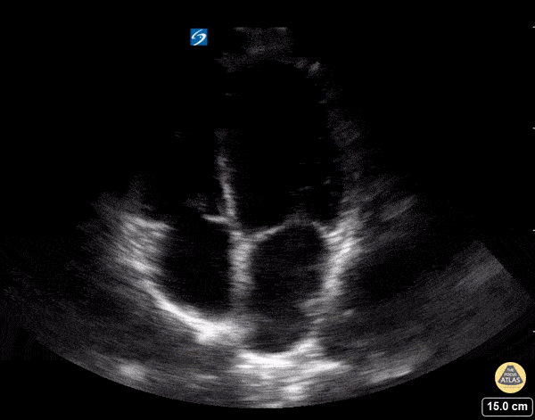
View through apex of heart in long axis.
Depth and Gain Optimised
Labelled A4Ch
Cineloop of at least 4 seconds
Demonstrate the left and right ventricles, atria and AV valves
Assess overall ventricular function normal vs abnormal
Assess LV and RV size as a ratio to each other
Identify a pericardial effusion and right heart inversion if present
Apical 4 Chamber View
A4CH

Slide 6
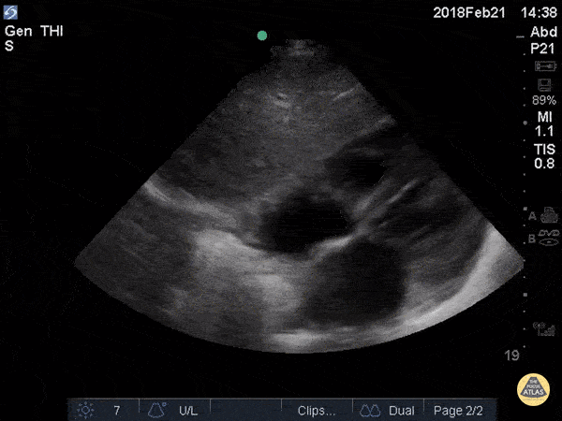
Transverse view through the subxiphoid region of the chest
Depth and gain optimised
Labelled SUBX
Cineloop of at least 4secs
Obtain a four-chamber view maximising the Left Ventricle (LV) length and minimising Right Ventricle (RV) foreshortening
Observe any free fluid over the Right Atrium (RA), RV and LV
Identify any 2D signs of RA RV inversion
Assess the size of the RV in relation to the LV
Assess LV and RV function
Subcostal/Subxiphoid View
SUBX

Slide 7
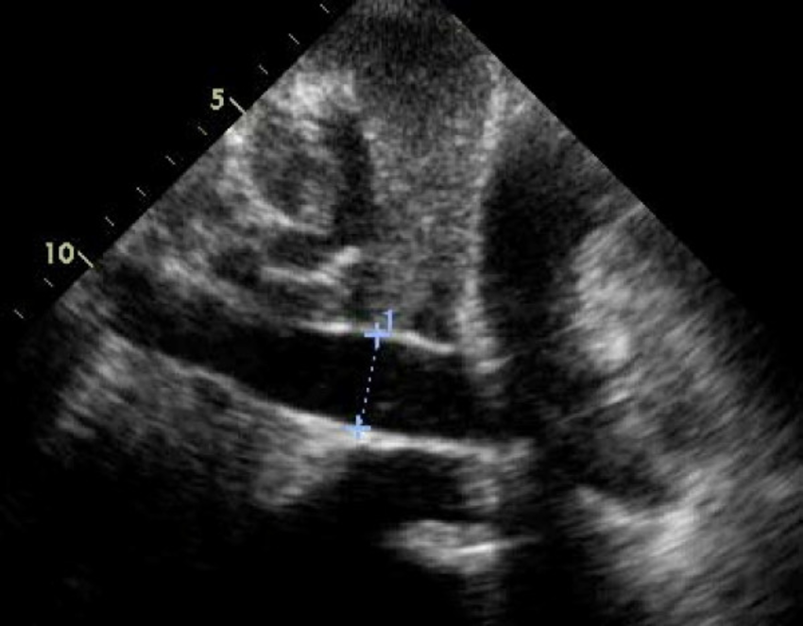
Long view of the Inferior Vena Cava entering the RA and traversing the liver
Depth and gain optimised
Labelled IVC
Freeze image and use callipers to measure the diameter of the IVC before the mouth of the hepatic vein
Identify collapsibility
M-Mode can be utilised to assess this.
Inferior Vena Cava Longitudinal View

